Slide 1
Rethinking Anonymity Online: A Multidimensional Approach and Measurement
Hana Machackova, Nikol Kvardova, Anna Literová, Tereza Halova, Petr Palíšek, Michal Mužík
Interdisciplinary Research Team on Internet and Society
Masaryk University | Faculty of Social Studies | Brno | Czechia E: hmachack@fss.muni.cz | W: irtis.muni.cz/

Slide 2
Why online anonymity?
Anonymity - common explanation for (online) behavior
But what is it?

Slide 3
What are the problems?
Conceptually: vague, brief, or no definitions
Methodologically:
very vague („are you feeling anonymous?“)
reductive - capturing just single aspect - (e.g., invisibility)
seen as binary construct
often presumed and not measured
Interdisciplinary concept – large variations of usage and emphasis
Psychological research – importance of the perception

Slide 4
Our key propositions
Anonymity online as perception
Percieved anonymity is multidimensional
Perceived anonymity is not binary
Perceived anonymity is affected by individual, social, and contextual – and digitally-contextual – factors
Perceived anonymity changes in time
Aim: new multidimensional model + new scale

Slide 5
The process
Literature review
Scoping review – focus on how anonymity is captured in SSH
Qualitative inquiry (focus groups)
Online survey testing proposed scale and dimensions

Slide 6
Distinction and specification of perceived online anonymity from…
its‘ predictors - e.g., the technical aspects, such as used platform
its‘ consequences - e.g., accountability for aggressive behavior, possible privacy violations
related constructs – e.g. (self-)disclosure or privacy

Slide 7
Challenges
The ideal aim: capturing the subjective perception
not technical anonymity or „objective“ description (formative indicators)
Full name – why does it make us unanonymous? „I would not put there my real name because…“
How can we ask about it?
Should we ask overly elaborately about it?
Can we not ask about it?

Slide 8
Dimensionality of the construct

Slide 9
Challenges
Example 1: Invisibility
„Can others see you“?
„Do you believe others can know your actual feelings / reactions“?
Example 2: Importance
„Do people know your ethnicity?“
„Do people know things that are important for you?“

Slide 10
Method – online survey
Czech adult population, age 18-54, N = 1,971
Survey via agency – online panel(ists)!

Slide 11
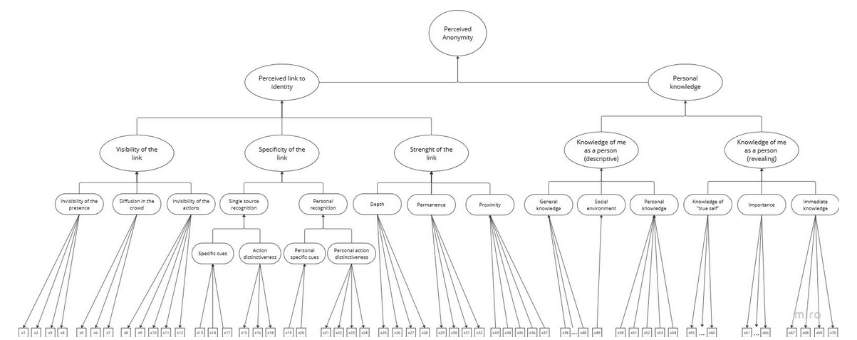
The proposed model

Slide 12
Results of the first wave
Changes in dimensionality structure
Problematic formative items (i.e., having non-significant weights and high inter-item correlations) were mostly reformulated for future data collections
Currently still testing the mixed (MIMIC) model

Slide 13
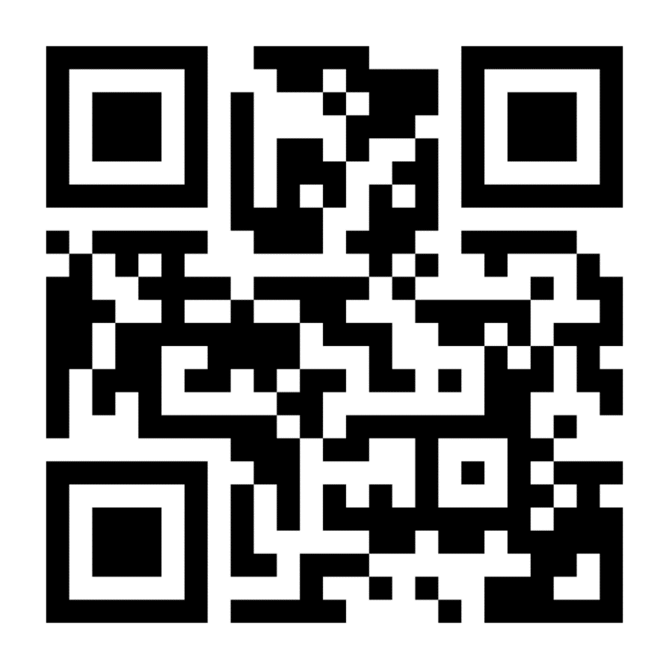
Thank you!
Irtis.muni.cz

Slide 14
Proposed model
PA as hierarchically organized construct
Combines reflective and formative approaches to latent variable modeling
Reflective subdimensions - causally active entities whose inter-individual variance translates probabilistically to the inter-individual variance in item responses
Formative subdimensions - causally passive, the weighted product of its indicators with an associated residual term
Mixed dimensions

