Slide 1
Examining the Reciprocal Relationship between Social Media Use and Perceived Social Support among Adolescents:
A Smartphone Ecological Momentary Assessment Study
Jana Blahosova, Martin Tancos,
Young Won Cho, David Smahel,
Steriani Elavsky, Sy-Miin Chow &
Michaela Lebedikova
Interdisciplinary Research Team on Internet and Society Masaryk University, Brno, Czech Republic
73rd ANNUAL ICA CONFERENCE
Toronto, Canada, 26th May, 2023

Slide 2
INTRODUCTION
1) Can communication and social networking apps influence perceived social support (PSS) differently? (Lapierre & Zhao, 2021)
2) Is there a reciprocal relationship between communication / social networking apps use and PSS?
3) Can we find this relationship at within-person level?
4) Can social anxiety moderate these relationships?
Communication apps
Social networking apps
T1
T1
T1
T1
T2
T3
between-person level
within-person level
Notes:
communication apps (for direct communication through text, video, audio, calls) such as WhatsApp, Telegram or Facebook Messenger
social networking apps (where users can communicate but also share content, collaborate, build networks and reach and involve big audiences) such as Facebook, Instagram, Twitter or TikTok

Slide 3
PROPOSED MODEL
SOCIAL NETWORKING APPS USE
T-1
COMMUNICATION APPS USE
T-1
COMMUNICATION APPS USE
T
SOCIAL NETWORKING APPS USE
T
SOCIAL ANXIETY
PERCEIVED SOCIAL SUPPORT
T-1
PERCEIVED SOCIAL SUPPORT
T

Slide 4
METHODS
May 2021
June 2022
ENTRY QUESTIONNAIRE
OUTPUT QUESTIONNAIRE
1. burst
May/June
2. burst
September/
October
3. burst
January/February
4. burst
April/May
4 surveys per day
daily objective measurement of app use
14 days, 2 weekends
195 adolescents, 13-17 years old, Mage = 15.02, 42,6% females
Notes:
1-year research study using ecological momentary assessment
Across the year, they completed four bursts of 2-week data collection. Each data burst, they installed the research app that sent participants four semi-random questionnaires per day and logged time adolescents spent in various smartphone apps for 14 days. Every day in evening questionnaire, they completed questions related to their daily perceived social support.
The data for this study come from the first 2-week measurement burst in May and June of 2021.

Slide 5
RESULTS
FIXED EFFECTS
COMMUNICATION APPS USE
T-1
SOCIAL NETWORKING APPS USE
T
SOCIAL NETWORKING APPS USE
T-1
COMMUNICATION APPS USE
T
-.13
-.02
-.02
-.11
SOCIAL ANXIETY
-.03
-.08
-.04
-.03
PERCEIVED SOCIAL SUPPORT
T-1
PERCEIVED SOCIAL SUPPORT
T
Notes:
Multilevel cross lagged model with random slopes did not find substantial effect of COM apps use on a previous day (such as Messenger or WhatsApp) and PSS the following day and vice versa
Social anxiety was not found as a moderator of these relationships
similar situation is for social networking apps (such as Facebook or Instagram) and their effect on perceived social support and vice versa.

Slide 6
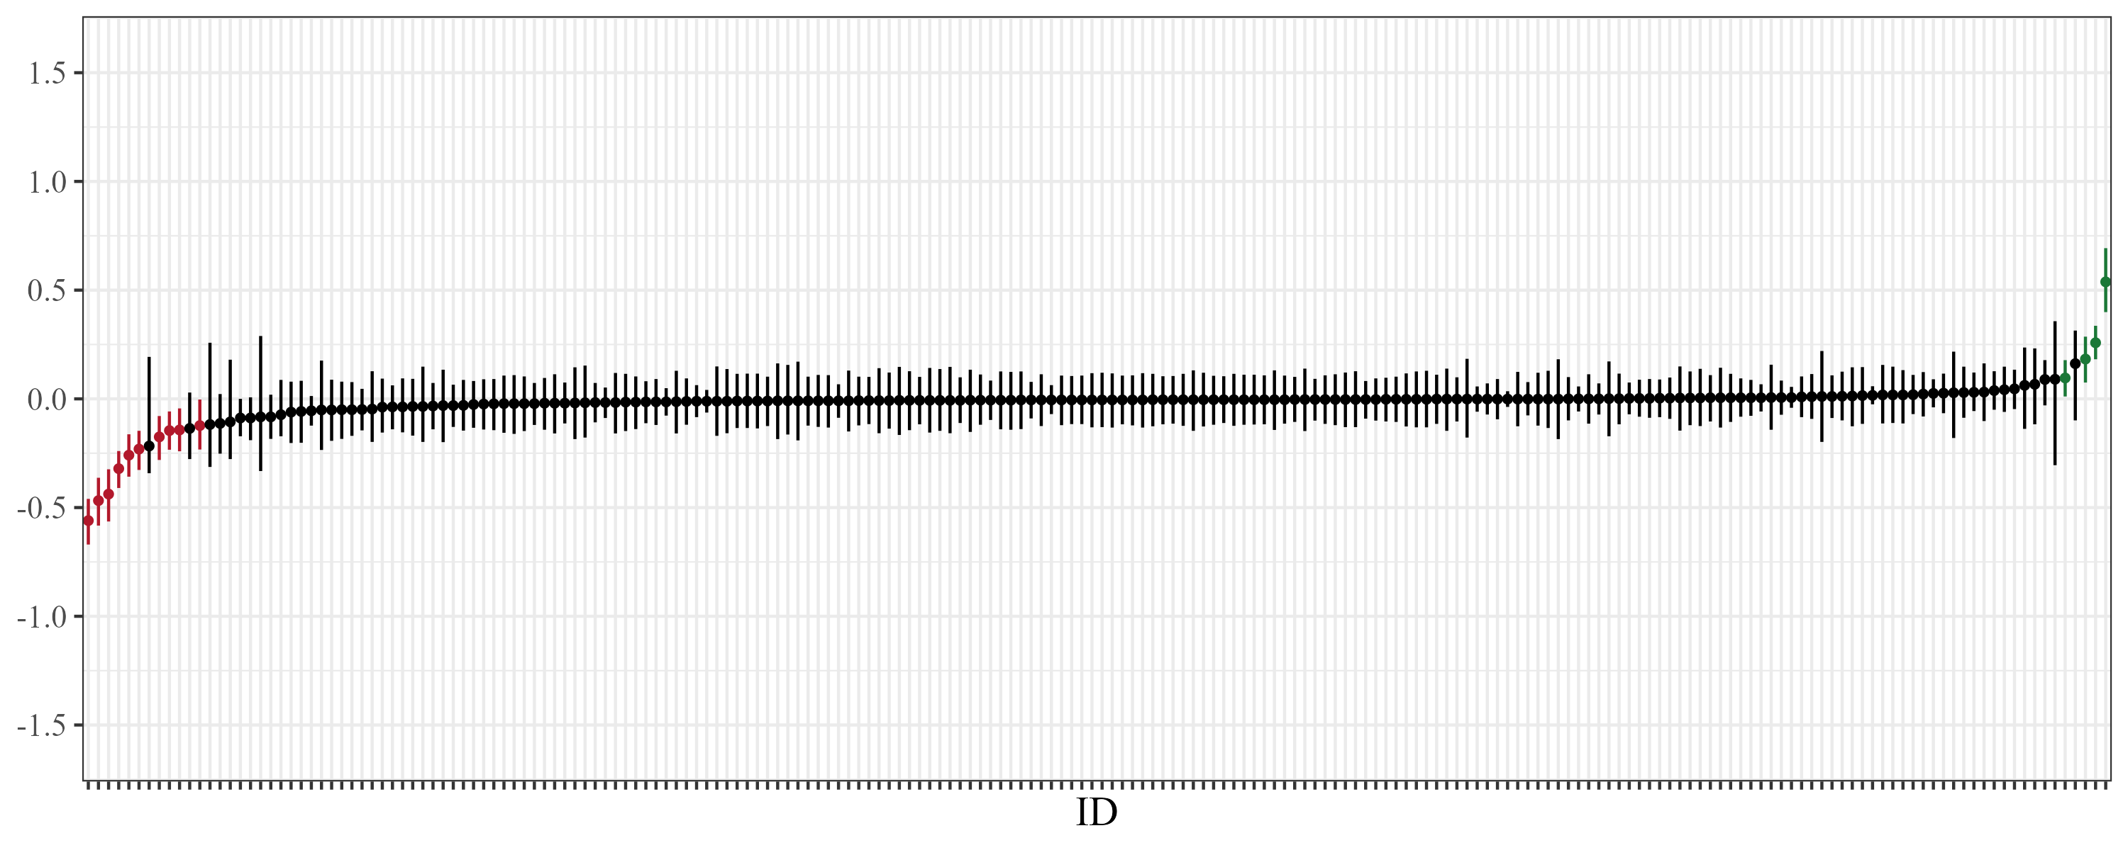
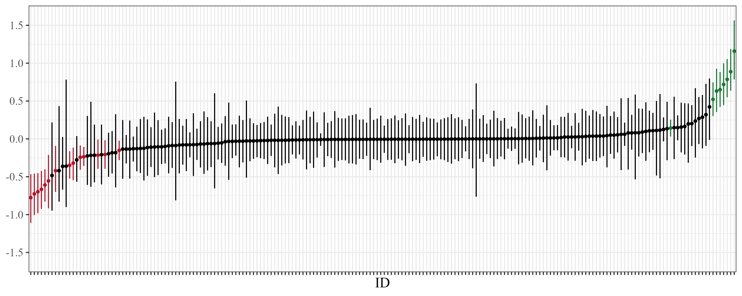
RANDOM SLOPES VARIANCES
perceived social support
→ communication apps use
perceived social support
→ social networking apps use
Notes:
We found quite substantial variance in some of these within person effects
Here you can see the graphs visualizing individual within person effect of perceived social support on communication and social networking app use
although the general within person effect was negligible, we can see that some of the adolescents experienced positive effect of PSS on social media use (the green points) and some of them experienced negative effect of PSS on social media use the following day (the red points)
in the case of SOCIAL NETWORKING APPS USE:
the green participants were adolescents with overall low levels of PSS and they were more likely to use SN apps more when their PSS from previous day was higher than usual
the red participants were adolescents with overall high levels of PSS and they were more likely to use SN apps more when their PSS from previous day was lower than usual

Slide 7
DISCUSSION
SOCIAL ANXIETY
MOOD MANAGEMENT THEORY
daily decrease of PSS may be caused by negative or stressful experience
adolescents want to escape from negative emotions – social media (Zillmann, 1988)
social anxiety does not seem to explain the individual differences in within-person effects
overall level of PSS could
Notes:
An explanation may be that adolescents who generally feel more supported are probably more sensitive to day-to-day decreases of social support

Slide 8
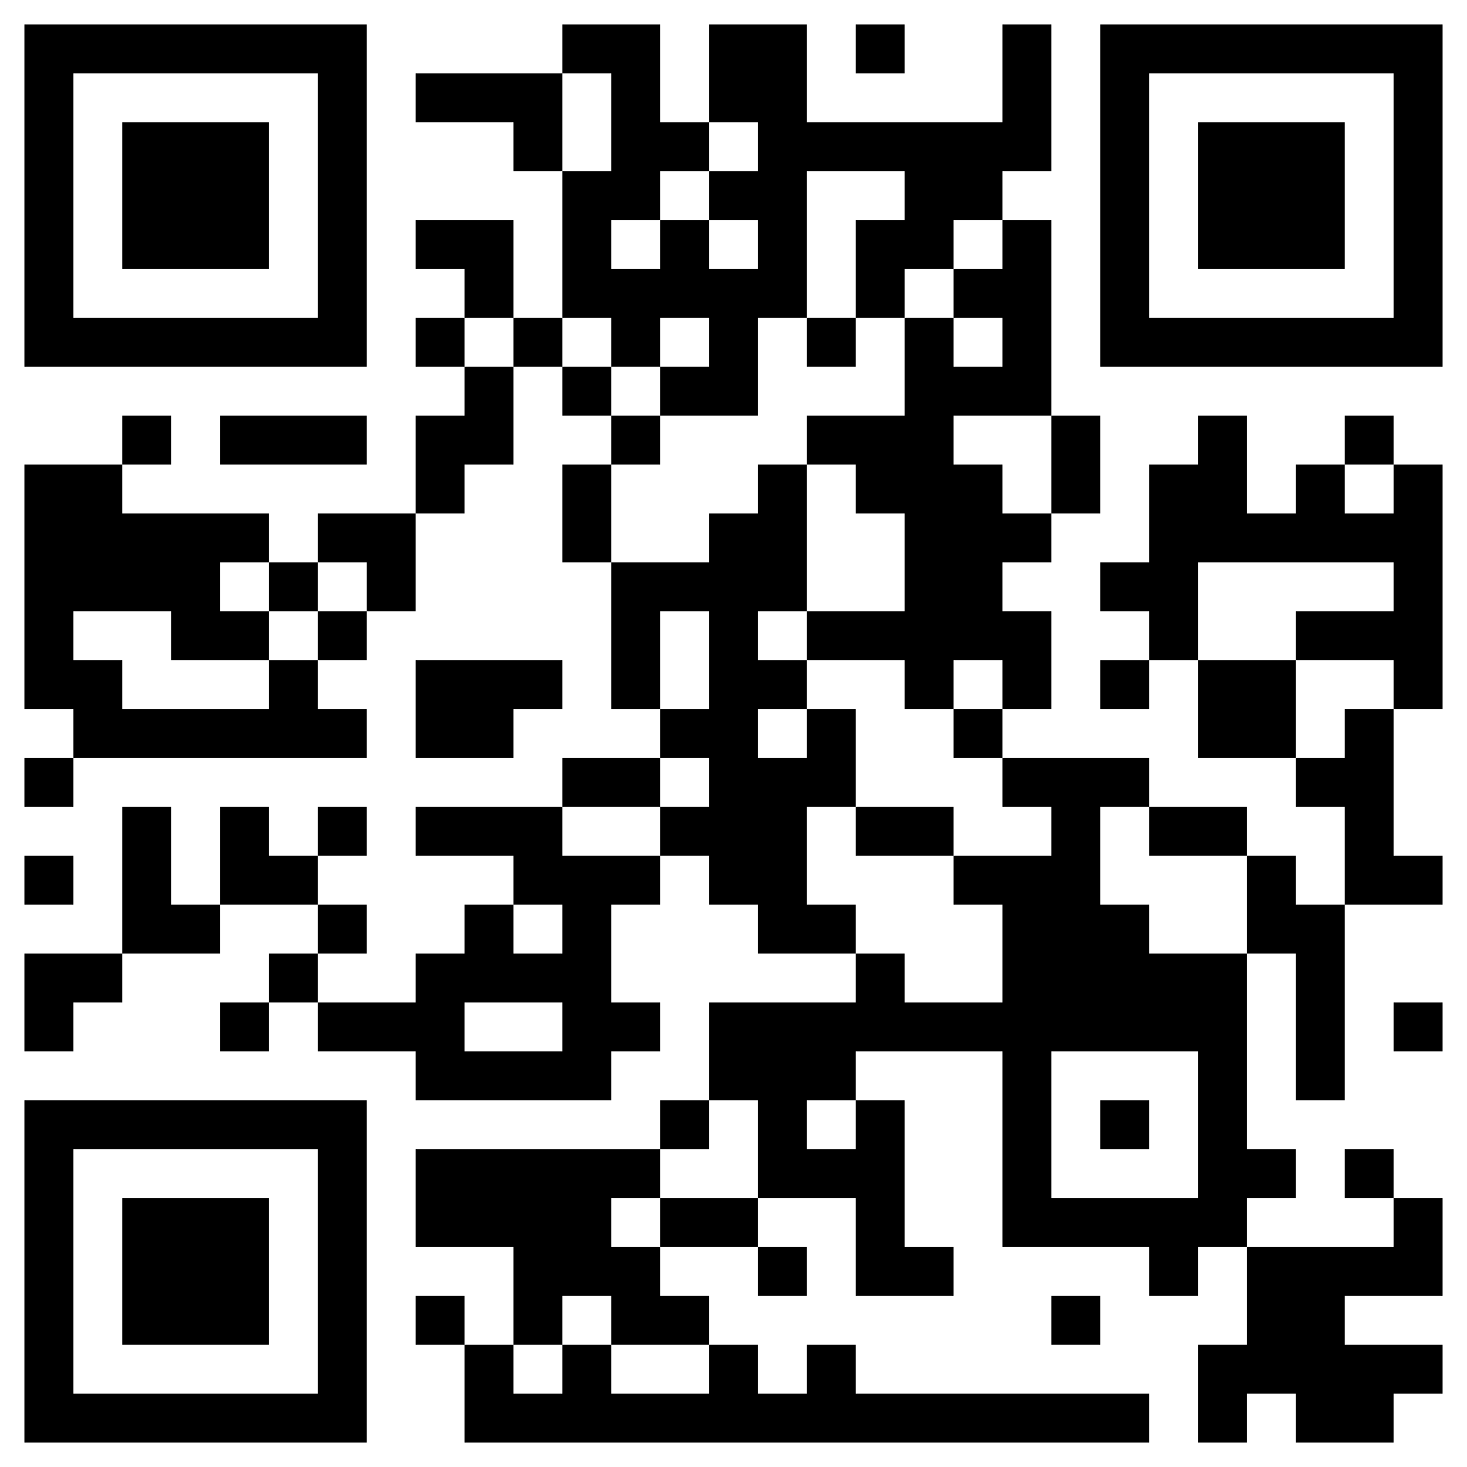
THANK YOU FOR YOUR ATTENTION
Jana Blahosova
www.irtis.muni.cz
www.twitter.com/irtis_muni
Credits: This presentation template was created by Slidesgo, including icons by Flaticon, and infographics & images by Freepik.

